Slide 1
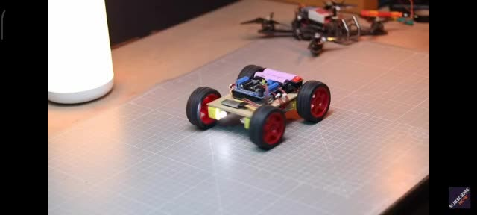
DR GROUP 10
2024
Arduino based gesture controll rover
01

Slide 2
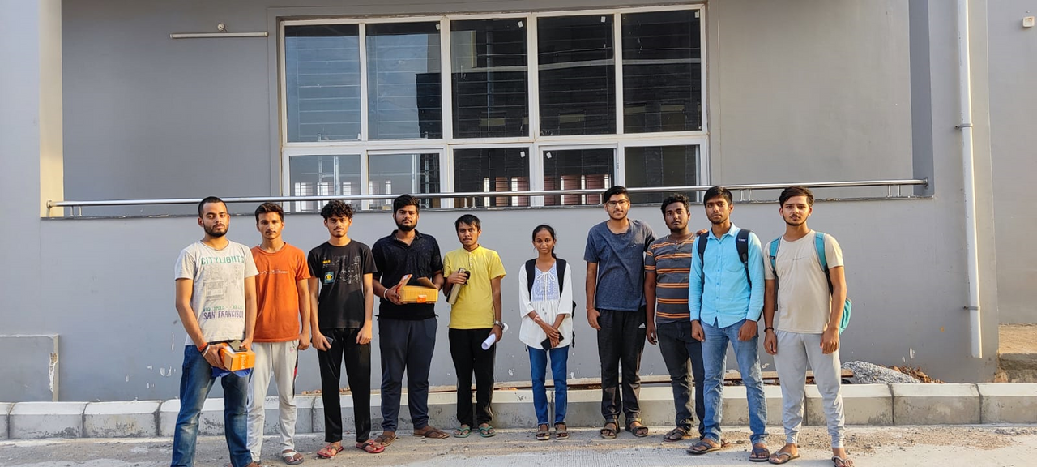
Meet Team
122EC0001 – Kruti Khemraj Lengure
122ME0031 – Harshvardhan Giri
122CS0072 – Ayush Mishra
122CS0032 - Ashutosh Mishra
122CS0058 – Ravi Shankar Kumar Yadav
122EC0021 – Hitesh Bhoyar
122EC0041 - Anjan Kumar Sharma
122CS0069 – Aditya Shankar
122ME0024 - Rubham Singh
122ME0028 – Aditya Kumar Rai
122CS0047 – Shubhankar Bhattacharya

Slide 3
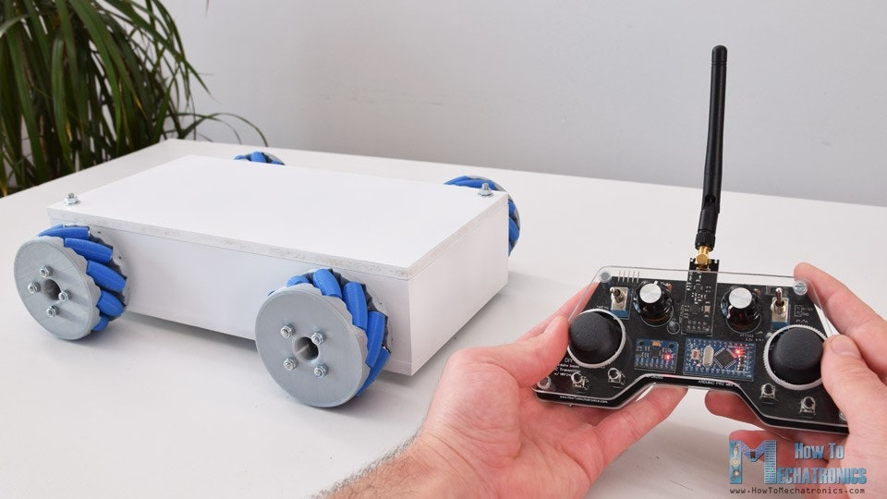
Introduction
Gesture controlled robots are a popular and exciting application of robotics.
In a wide variety of fields, these types of rovers could be employed.

Slide 4

Objectives
01
To design and build a functioning gesture-controlled rover.
02
To develop a reliable and accurate Motion recognition system.
03
To integrate various sensors and camera into the rover.
04
To optimize the design of the rover.

Slide 5
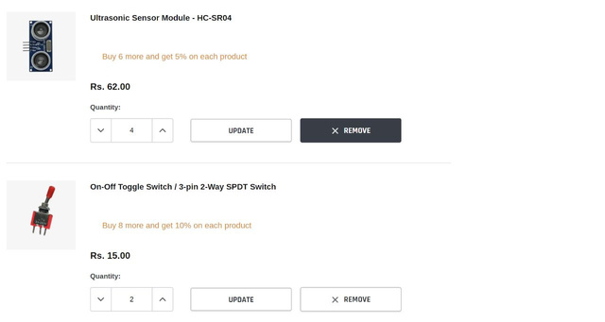
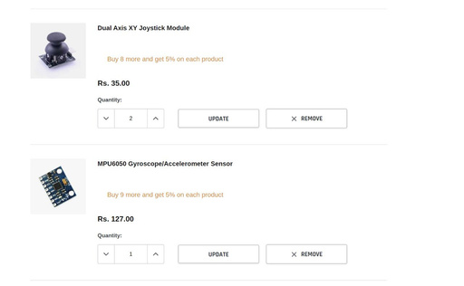
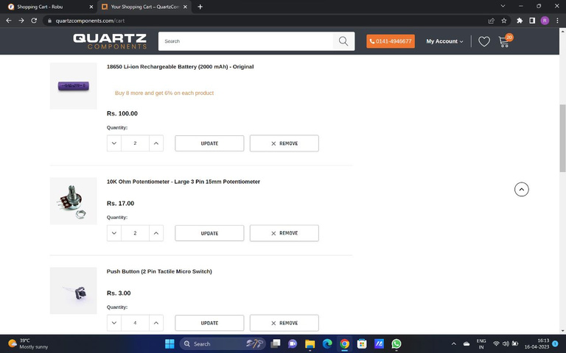
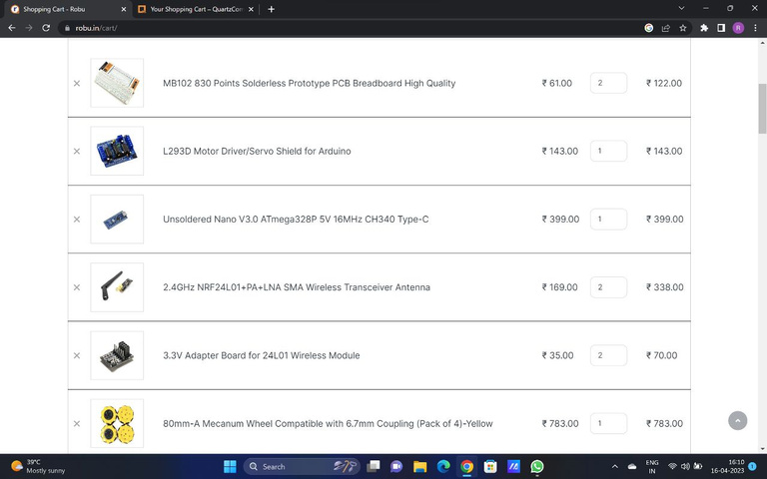
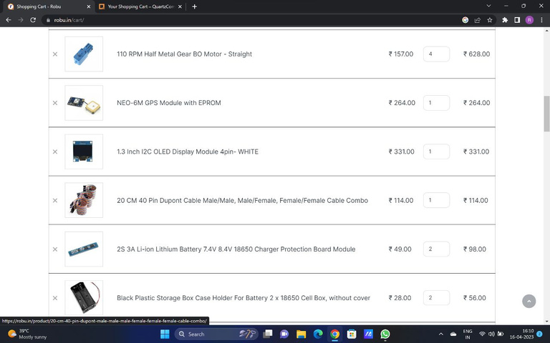
Planning
Selection of Project
Checking feasibility of project
Making a rough estimate of budget
01
02
03
Ordering Components :

Slide 6
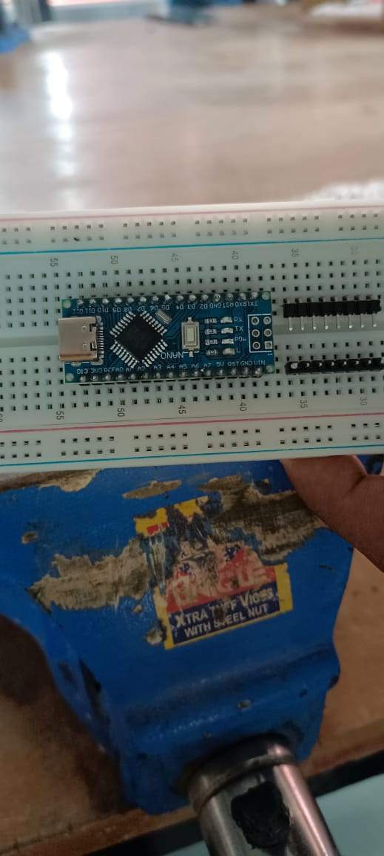
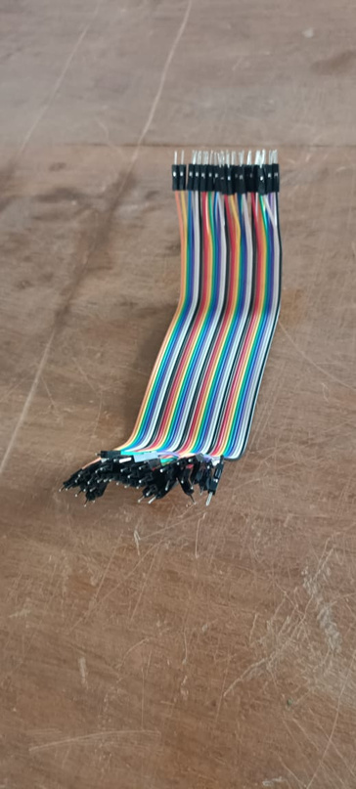
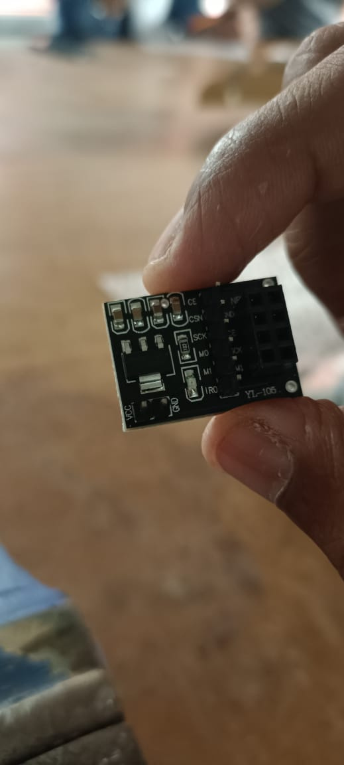
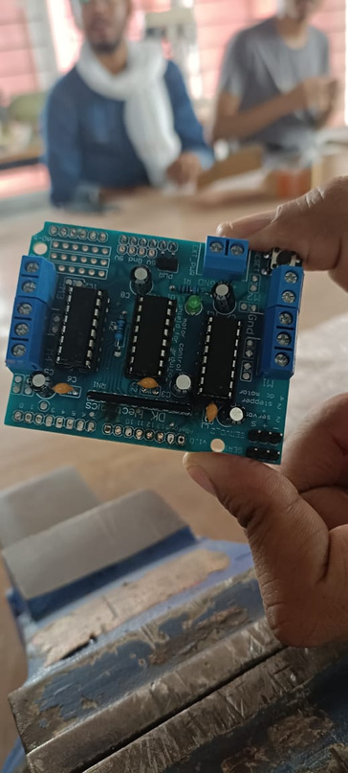
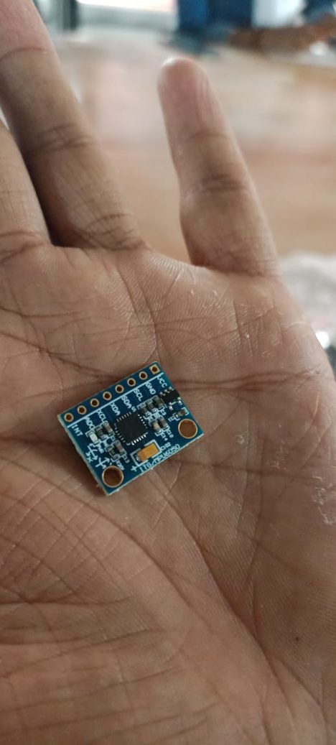
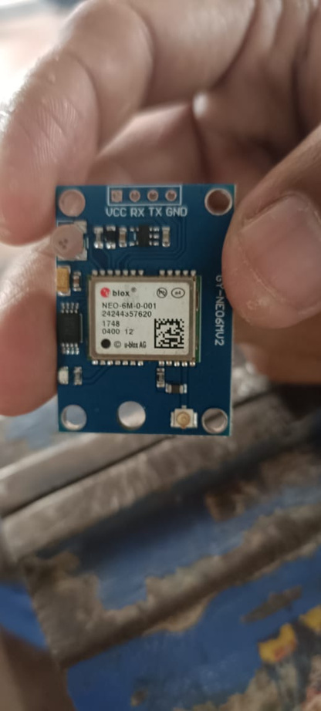
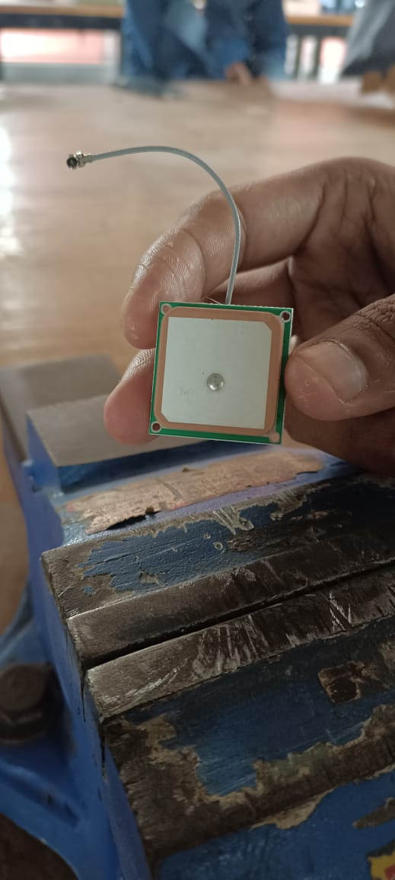
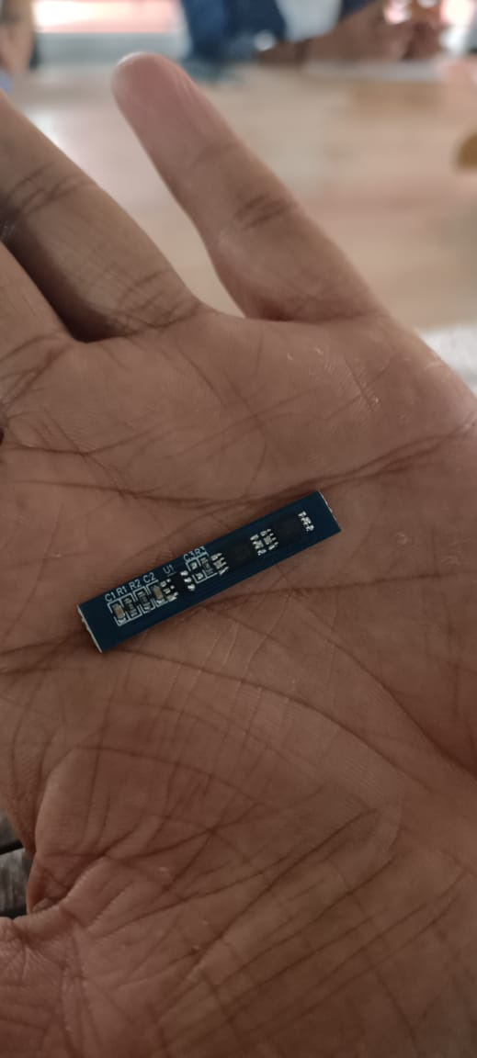
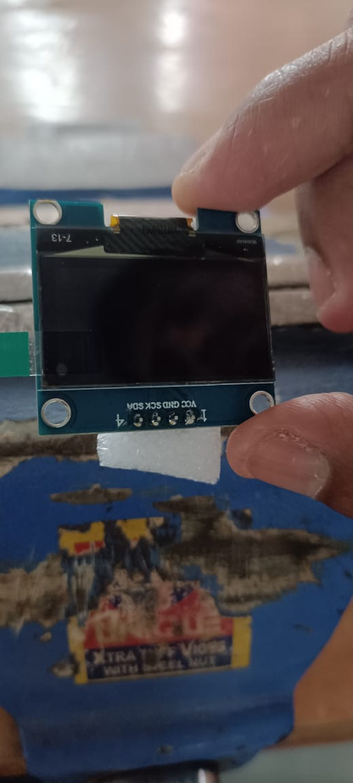
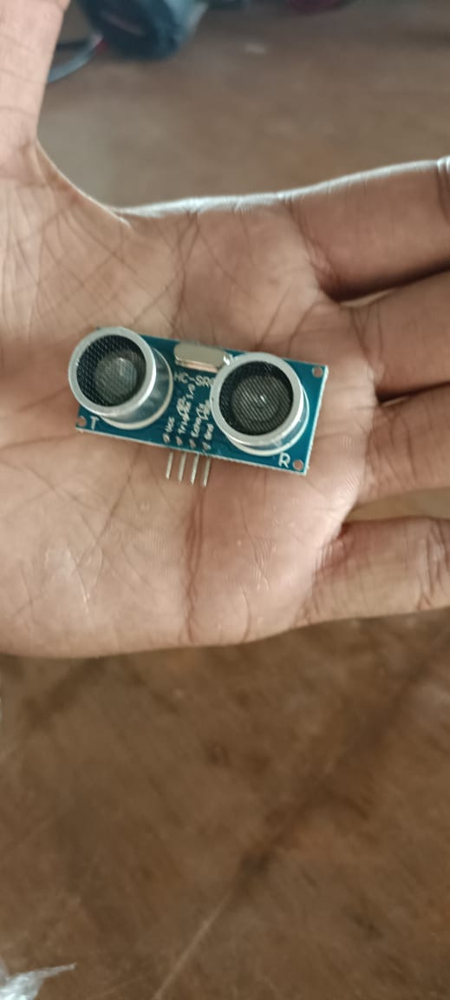
Components
Arduino Nano
Dupont Cables
Adapter Board
Motor Driver
Gyroscope Sensor
GPS Module with EPROM
Charger protection Module
OLED Display Module
Ultrasonic Sensor

Slide 7
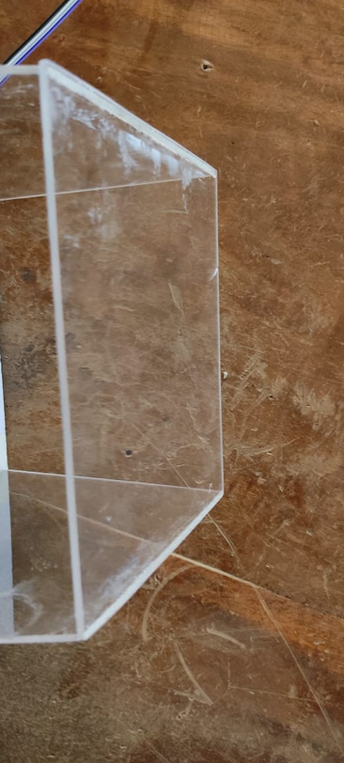
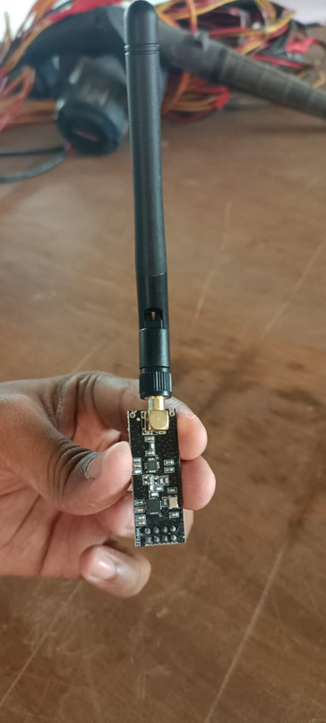
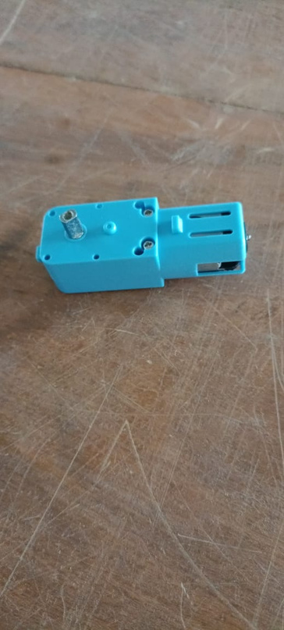
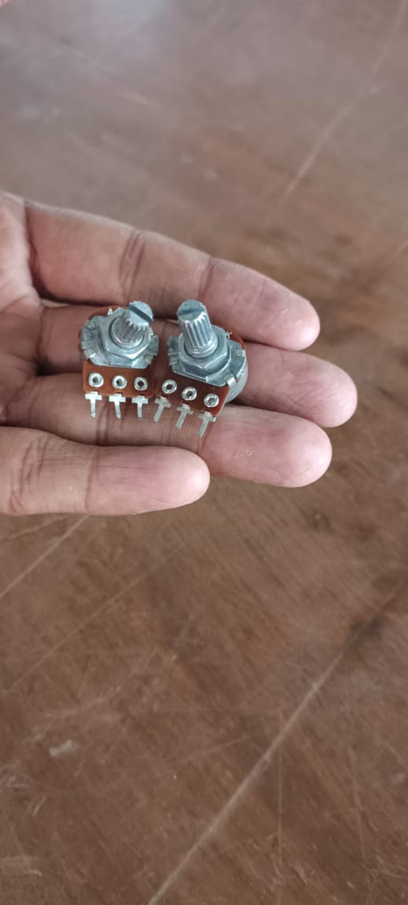
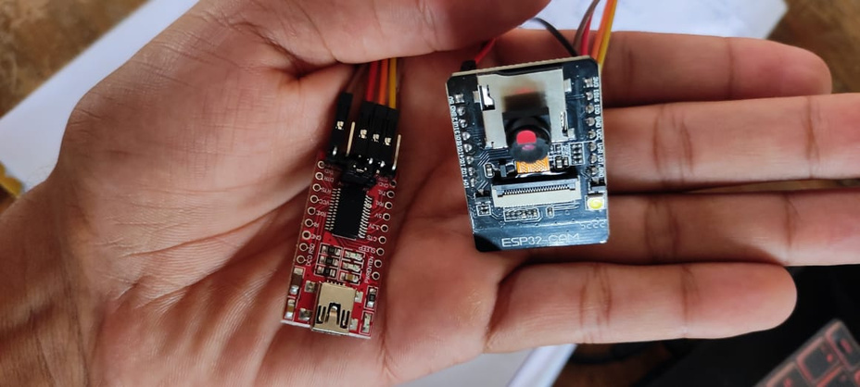
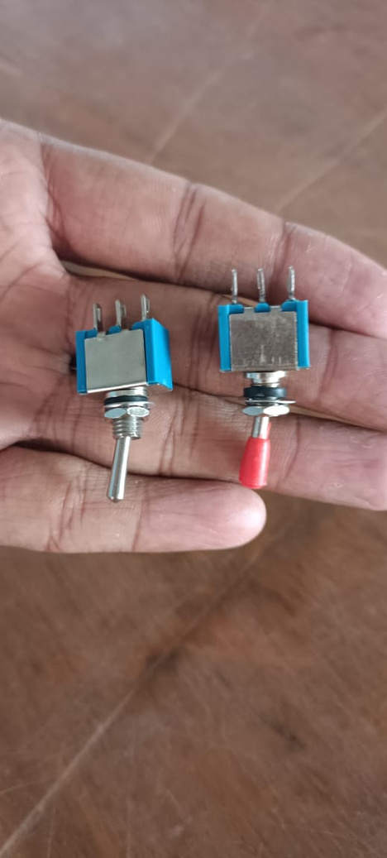
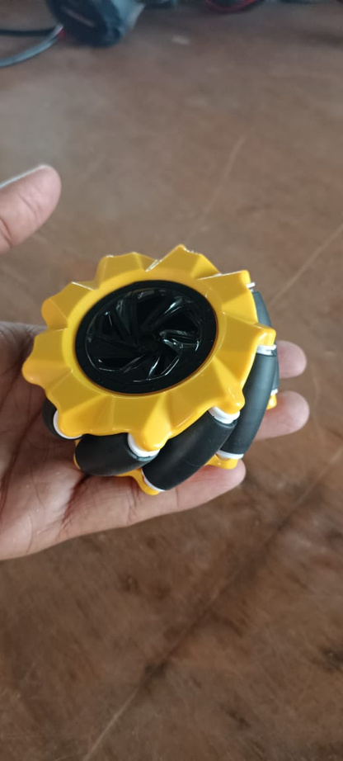
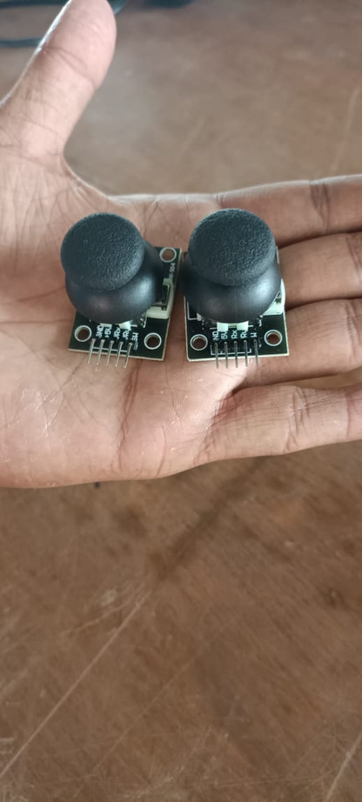
Components
Metal Gear Motor
Acrylic Sheet
Potentiometer
Transceiver Antenna
ESP32 Camera with nano
Toggle Switch
Mecanum Wheel
Joystick Module

Slide 8
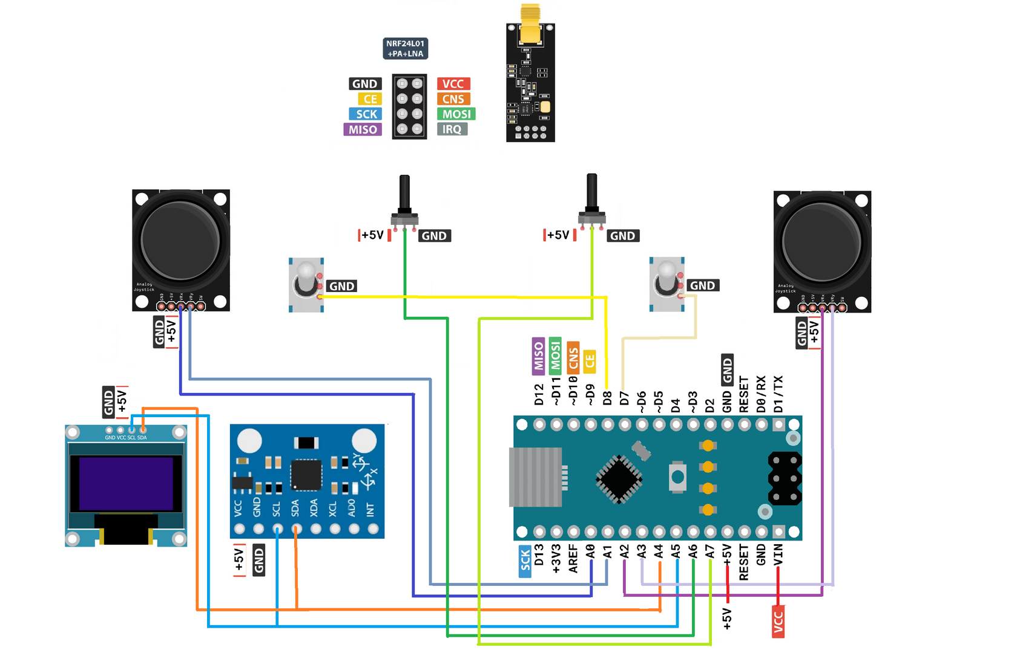
Circuit Diagram
Rover Controller

Slide 9
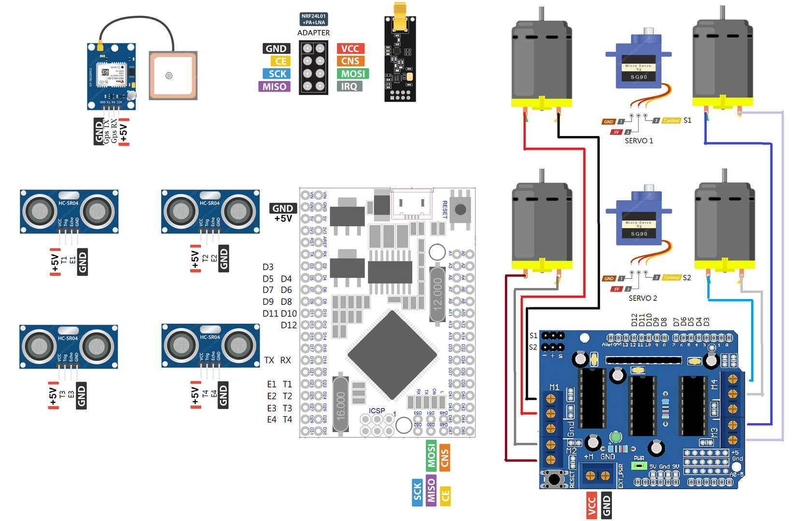
Circuit Diagram
Rover

Slide 10
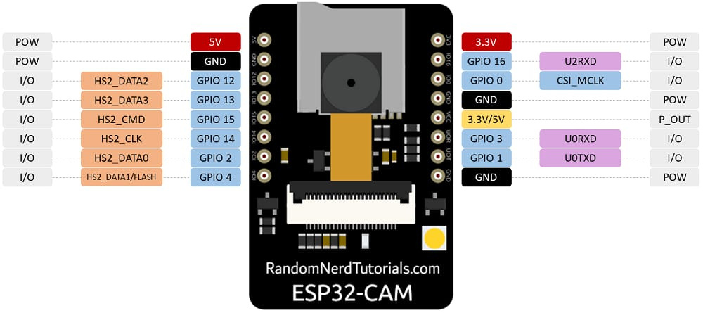
Circuit Diagram

Slide 11
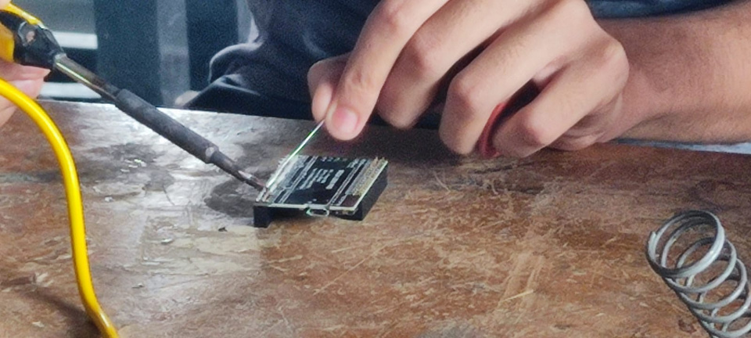
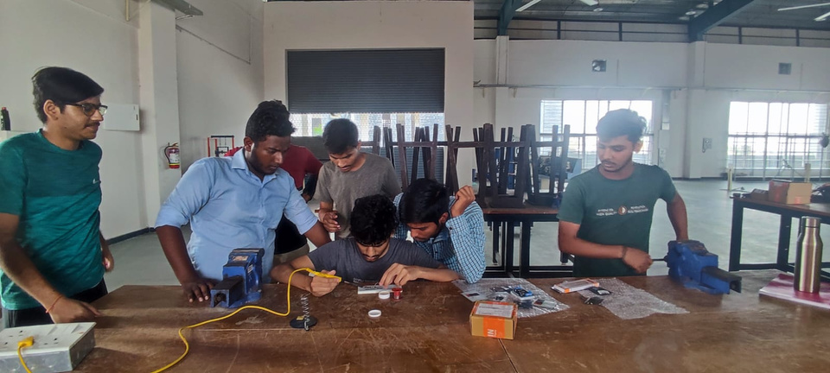
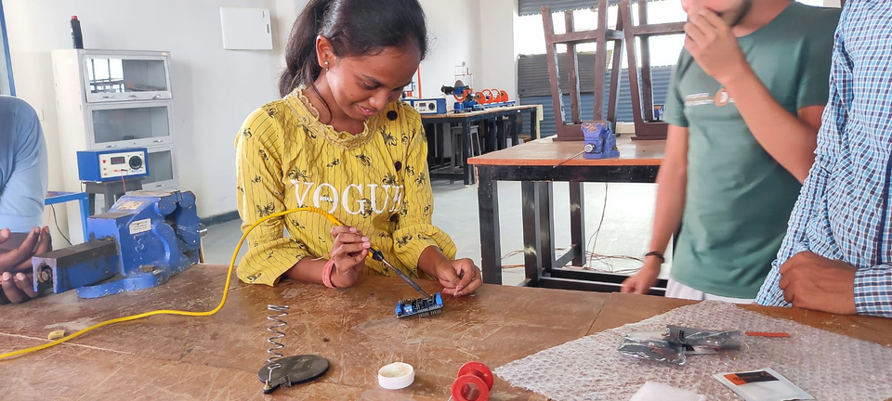
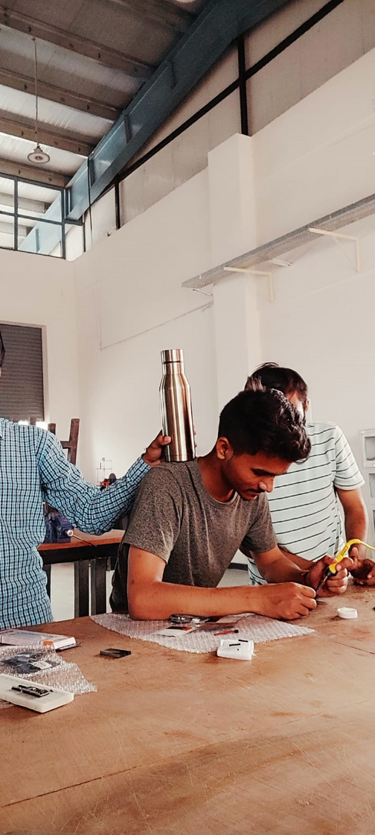
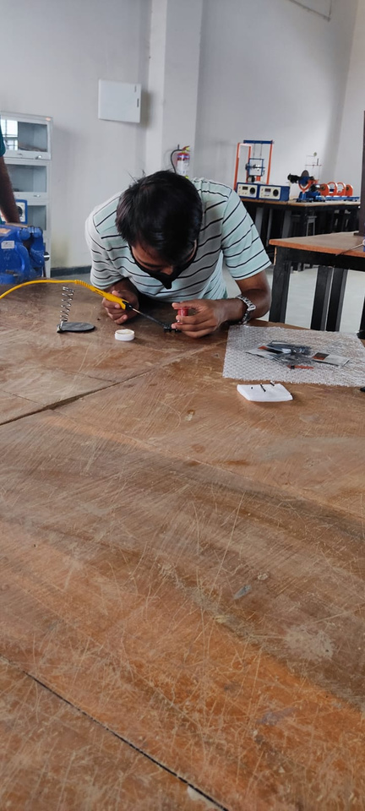
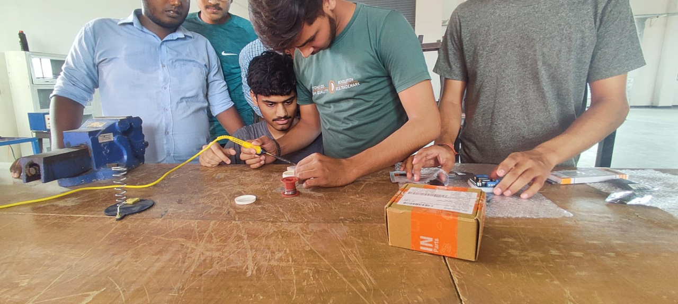
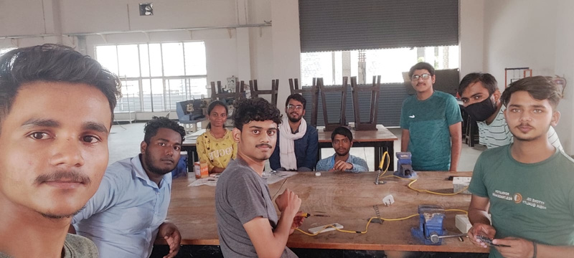
Making Circuit
Soldering circuit
Making proper connections
Testing Connections

Slide 12
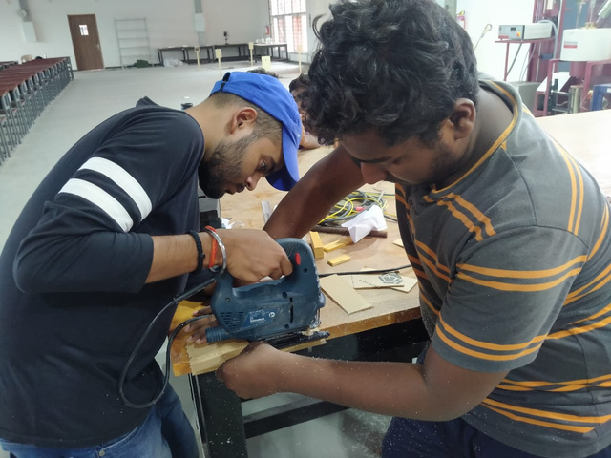
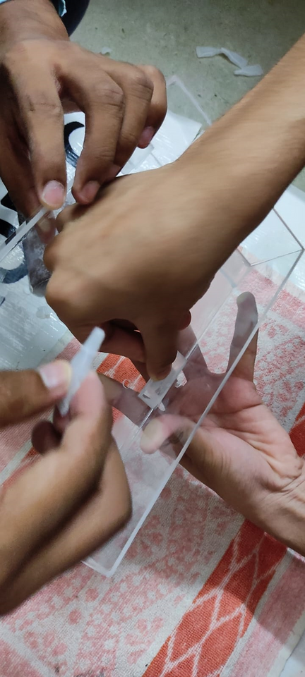
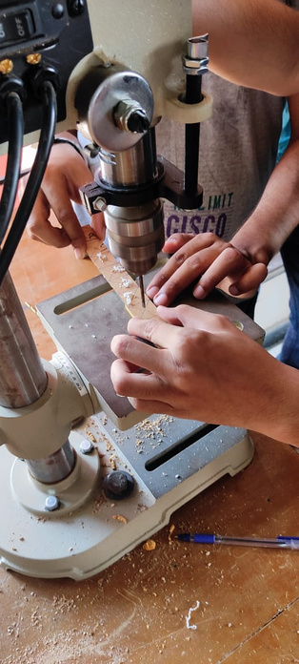
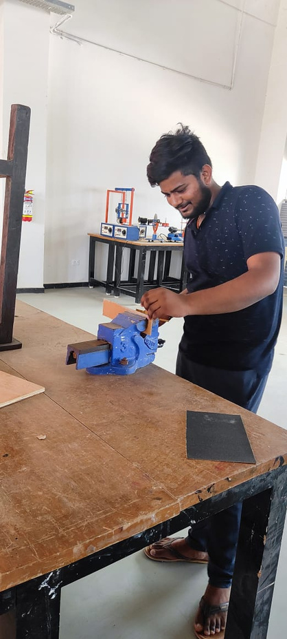
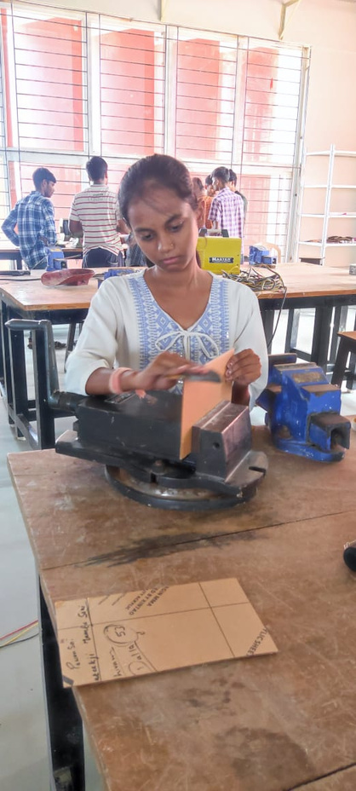
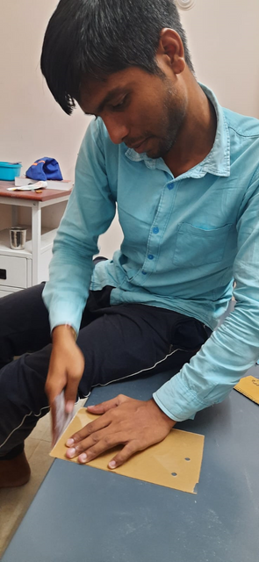
Making Outer body
Cutting Acrylic Sheet
Drilling on required locations
Smoothing edges with sandpaper
Joining sheet to make rover body

Slide 13
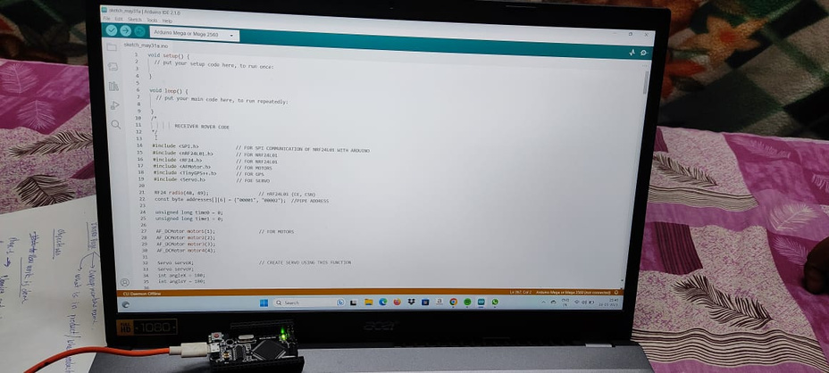
Inserting Code
RECEIVER ROVER CODE :
#include <SPI.h> // FOR SPI COMMUNICATION OF NRF24L01 WITH ARDUINO
#include <nRF24L01.h> // FOR NRF24L01(Wireless Antenna)
#include <RF24.h> // FOR NRF24L01
#include <AFMotor.h> // FOR MOTORS
#include <TinyGPS++.h> // FOR GPS
#include <Servo.h> // FOE SERVO

Slide 14
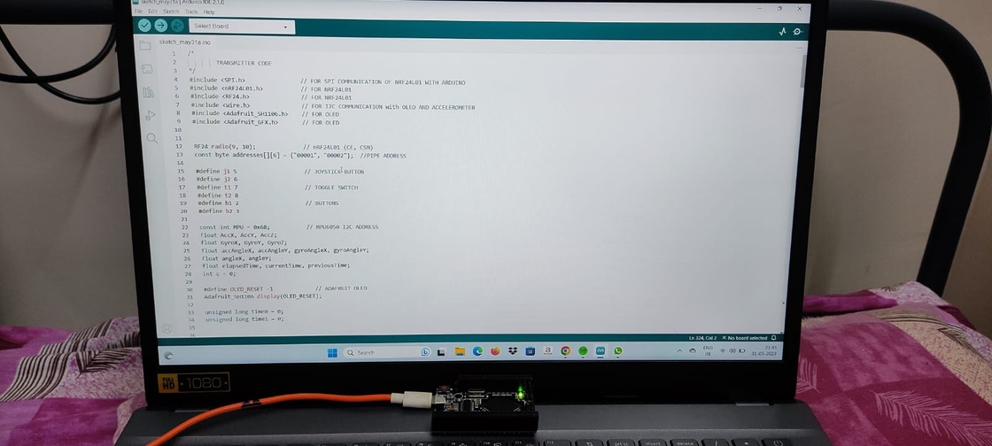
Inserting Code
TRANSMITTER ROVER CODE :
#include <SPI.h> // FOR SPI COMMUNICATION OF NRF24L01 WITH ARDUINO
#include <nRF24L01.h> // FOR NRF24L01(Wireless Antenna)
#include <RF24.h> // FOR NRF24L01
#include <Wire.h> // FOR I2C COMMUNICATION with OLED AND ACCELEROMETER
#include <Adafruit_SH1106.h> // FOR OLED
#include <Adafruit_GFX.h> // FOR OLED

Slide 15
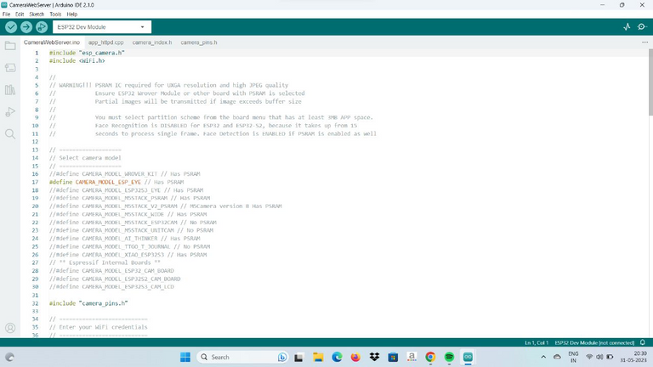
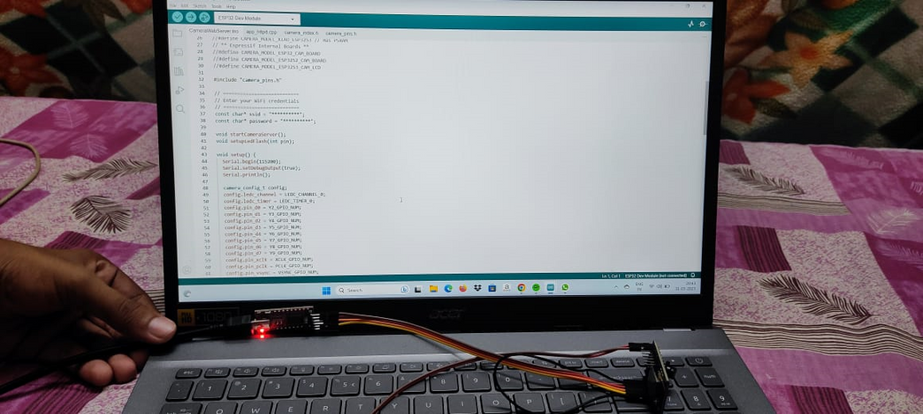
Inserting Code
ESP32 CAMERA CODE :
#include <esp_camera.h> // FOR ESP32 Camera
#include <Wifi.> // FOR wifi connection
#include <camera_pins.h> // FOR Camera pins

Slide 16
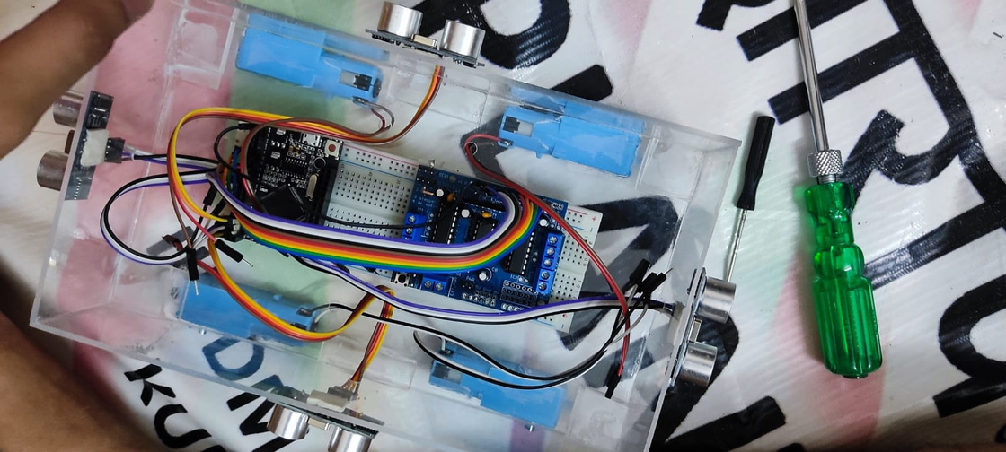
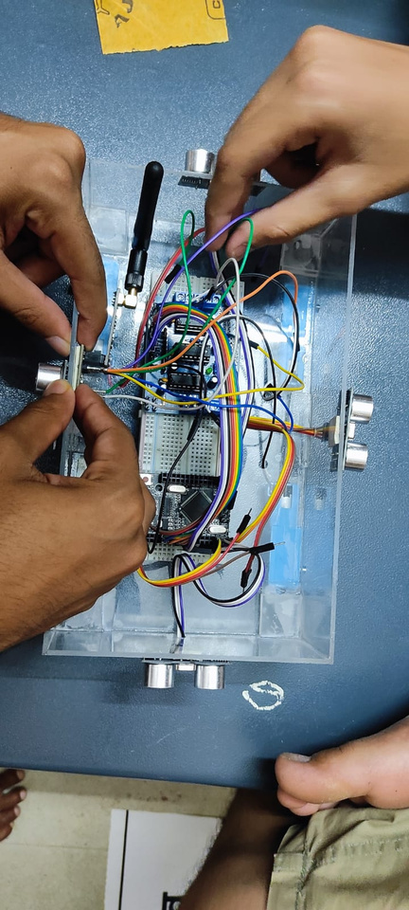
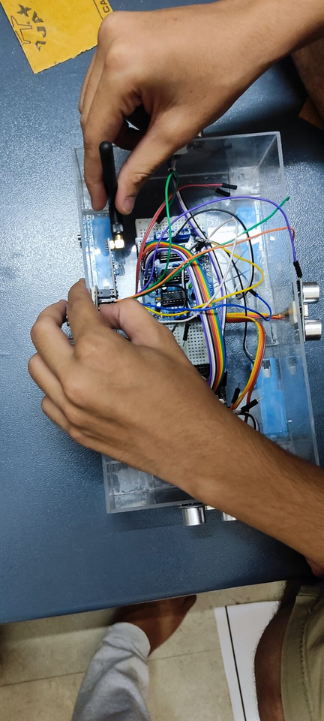
Assembling
Placing modules in body
Setting sensors
Installing motors and wheels
Connecting circuits

Slide 17
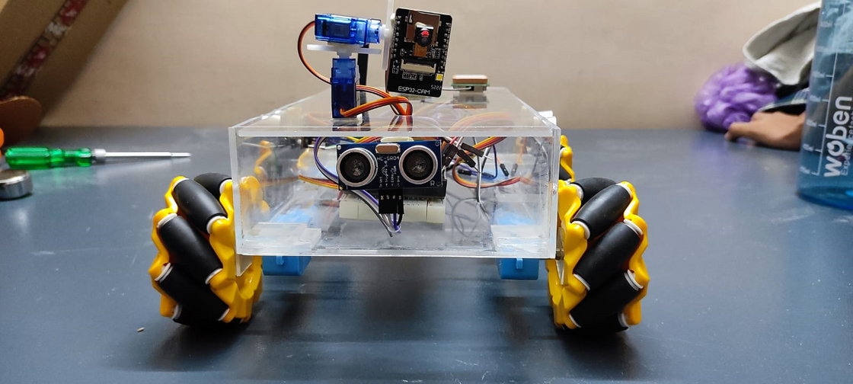



Final Rover
Top View
Front View
Side View

Slide 18


GROUP NO. 10
Thank You
01

